Slide 1
Senior Seminar Campbell High School Technical & Two Year College Information

Slide 2
Members of the Counseling Office
608
School Counseling Office-Room 608
A – Con Mrs. Loftin
Cook – Har Mrs. Ellison-Brown
Hat – Ma Dr. Amand
Mc – Rob Mrs. Wright
Roc – Say/ESOL/AVID Mrs. Schloemer
Sco – Z Mrs. Jackson
Registrar/Dual Enrollment Mrs. Beasley
College and Career Consultant Mrs. Ndah
College Visits Mrs. Washington
Transcripts Mrs. Askew
Records/Address Change Mrs. Askew
www.campbellhscounseling.com

Slide 3
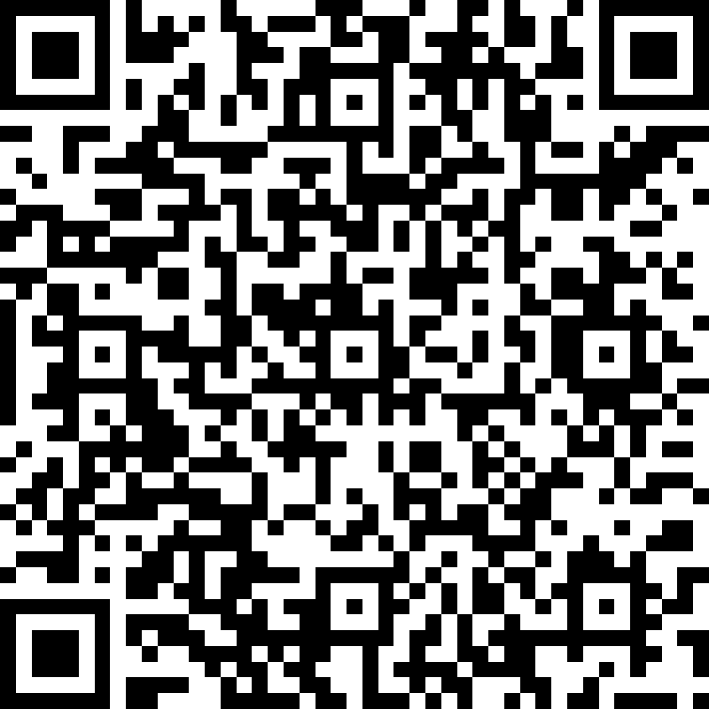
Pre Test

Slide 4
Lesson Overview
Important Dates
Graduation Status Reports
Technical College Overview
HOPE Grant/HOPE Career Grant
Two Year College Overview
Application Procedures
Social Media
Naviance
Bridge Law

Slide 5
Important Dates
Sept. 9th –PROBE Fair 6-8 p.m. –Marietta High School
Sept. 12th – College Info Night – 6-8 p.m. CHS AUD
Oct. 8th – Financial Aid Workshop – 9 – 11a.m. CHS Auditorium. Sign up for this on counseling website starting 09/04/2019.
Oct. 24th - ASVAB - sign up in Counseling Office
March 13th – College and Career Fair – CHS

Slide 6
Graduation Status Report
Details what you still need to pass to graduate
Check your transcript
Any questions? See your counselor

Slide 7
Technical College
Chattahoochee Technical College
www.chattahoocheetech.edu
Certificates in specific areas – programs last a few weeks to few months in length.
Diplomas – programs last a few months to a year in length.
Associates Degree – two year college degree – credits can be transferred to any college in GA and possibly out of state.

Slide 8
Technical College System of Georgia
22 Colleges – 600 programs!
Research programs at other Technical Colleges in Georgia
https://tcsg.edu

Slide 9
HOPE Grant
Money for college from the state of GA.
Not based on your high school GPA.
Available at any Georgia college that offers certificate or diploma programs.
Pays about 89% of your tuition each semester ($1,560 for 12 hours)
To keep the HOPE Grant, maintain a college GPA of 2.0.

Slide 10
High Demand Careers HOPE Career Grant-100%
Automotive Technology
Aviation Maintenance
Certified Engineer Assistant
Commercial Truck Driving
Computer Programming
Computer Technology
Construction Technology
Diesel Equipment Technology
Early Childhood Care and Education
Electrical Lineman Technology
Health Science
Industrial Maintenance
Logistics/Transportation Technology
Movie Production Set Design
Practical Nursing
Precision Manufacturing
Welding and Joining Technology

Slide 11
Two-Year College
Georgia Highlands College
www.highlands.edu
Georgia State Perimeter College
www.perimeter.gsu.edu
University of North Georgia Two-Year Campuses
www.ung.edu
These offer Associates Degrees – you can start a career or use the credits to transfer to a 4-year college.

Slide 12
Application Procedures
Apply spring of Senior Year by visiting the colleges’ websites; look under “Admissions.”
Send your high school transcript to the college.
Take the colleges’ placement test on the college campus (ACCUPLACER – cost $25)– or send SAT/ACT scores if you have them.
www.accuplacer.org – practice tests
Take a tour of the different campuses you are considering.

Slide 13
Social Media & Digital Footprint
Email address – make sure yours is appropriate
Check your email account at least twice a week.
Clean up your on-line interactions – employers may check your social media
Be sure to use the organization’s social media avenues for tips and information.

Slide 14
Naviance
Naviance is a delivery system and college/career search engine and it is also how we communicate with YOU and your parents throughout the year.
Naviance is a delivery system and college/career search engine, but it also how we communicate with YOU and your parents, throughout the year.

Slide 15
What is Naviance?
Seniors only:
Adding colleges that you are applying to so transcripts can be sent to the colleges on your behalf
Access all scholarships
Register for College Visits (Jrs too)
All students:
Calendar of colleges visiting CHS
College and Career Planning/exploration
Research colleges
Resume building
Communicating with your Counselor
Scholarship searches
Interest inventories
Finding your strengths
Learning Styles Inventory

Slide 16
Logging into Naviance
If you’re on a CCSD computer, then you will be automatically logged into Naviance
You can access Naviance from the CCSD homepage and the CHS website
To log into Naviance from home, you will use the following:
User Name: | Password:
Office 365 username first.last@students.cobbk12.org | Lunch Number/CCSD STID

Slide 17
Enter your email address
We need your email address so we can communicate important information with you. Please get in the habit of checking email frequently.
Click on the “About Me” link at the top
Click on “My Account”
Click on the Pencil Icon in the “Contact Information” box
Enter your email address
Click “Save”

Slide 18
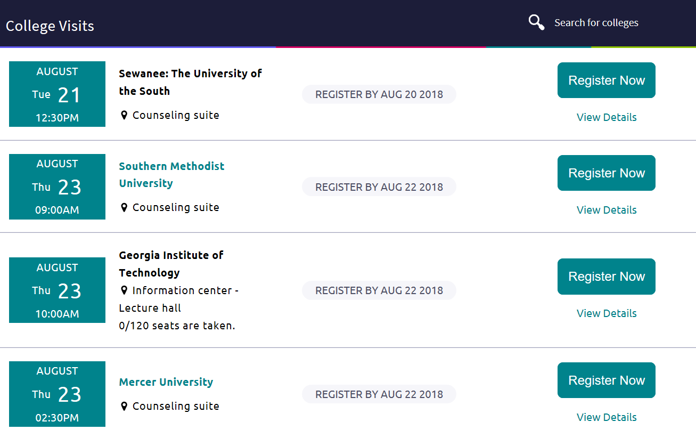
College Visits
Check Naviance at a minimum of 3X a week for upcoming college visits. Visits start in September!
You will be allowed to attend a maximum of 5 visits
There are only 25 spots per visit except for higher interest schools like KSU, Ga State, and more
Registering for the visit cuts off 2 hours in advance of the visit. If the visit is at 10am, you cannot register after 8am.
We will NOT send you a pass to attend the visit. Please show your registration via device to your teacher to be allowed out of class.

Slide 19
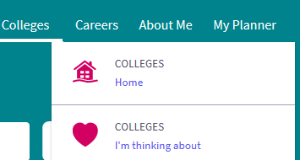
Scholarship searching on Naviance
Scholarships CHS & CCSD posts
(including local scholarships specific to CHS students)
Search engine

Slide 20
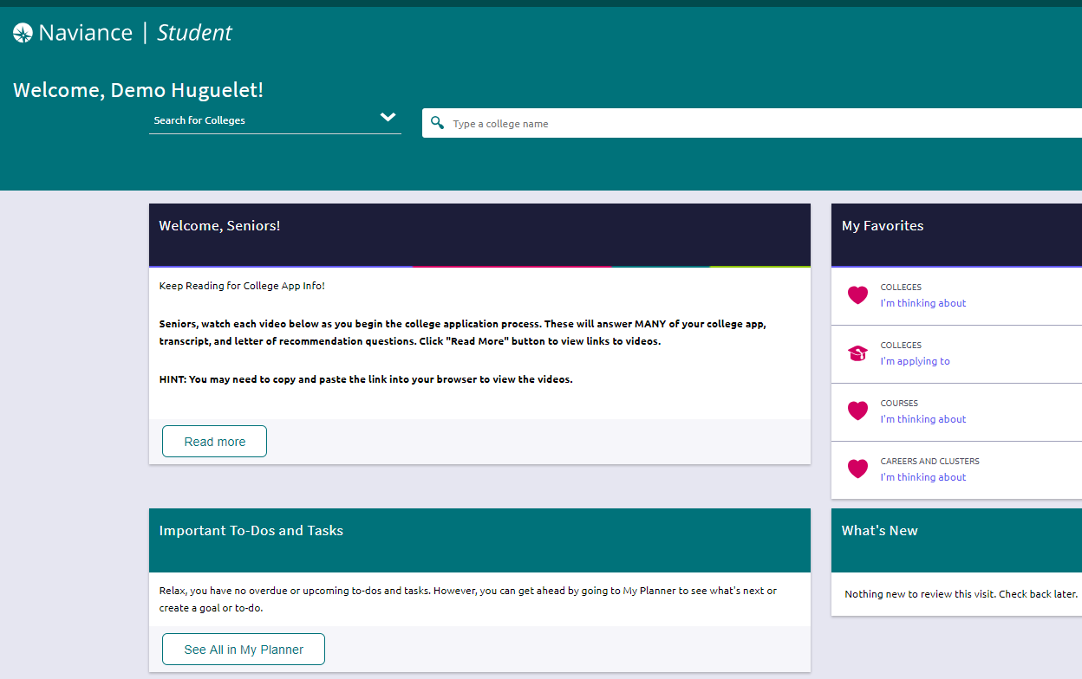
Naviance Student Homepage

Slide 21
Colleges “I’m Applying to Dashboard”

Slide 22
How we will submit your documents

Slide 23
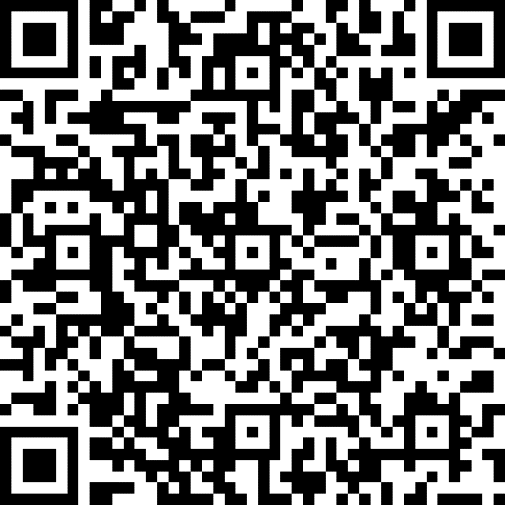
Post Test

Slide 24
Have a great senior year
Questions

Slide 25
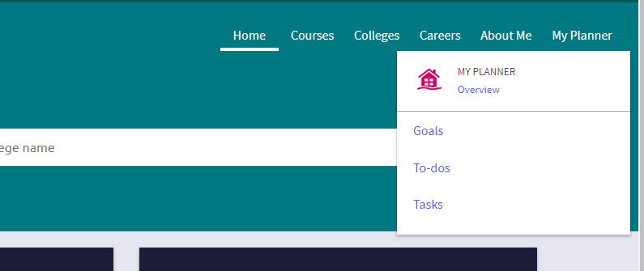
Bridge law
Go to “My Planner” and click “Tasks”

Slide 26
Bridge law
Scroll down to “Tasks You Need to Work On”
Complete Task by selecting: “Complete Senior Survey”
Select “take this survey” in the upper right hand corner to begin the activity
Answer the question and select “Save and Finish”

Slide 27
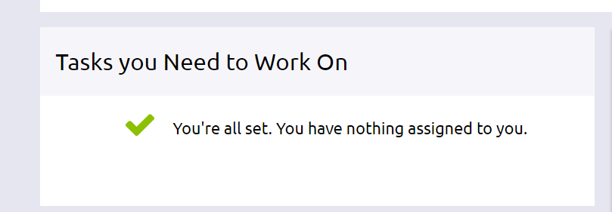
Don’t log out
Wait for a counselor to confirm your completion
Go to “My Planner” and then “Tasks” to show completion status

